Slide 1
UNIT 4 SEMANTICS AND PRAGMATICS
EHSG

Slide 2
What are Semantics
Study of meaning in language
Deals with:
Meaning of words (Lexical semantics)
Meaning of phrases and sentences (Compositional semantics)
Notes: Example: “John likes Mary” vs. “Mary likes John” — same words, different meanings due to structure.

Slide 3
What is Pragmatics
Concerned with use of language in context
Involves:
Speaker intentions
Discourse context
Conversational implicatures
Example: “Can you open the window?” — a request, not a question about ability.

Slide 4
Need for Representation
Computers require explicit (clear) representation of meaning;
Representation must be:
Unambiguous (unaffectively)
Machine interpretable
Mappable to linguistic structure
Notes: Show contrast between natural language ambiguity and formal representations like First-Order Logic (FOL) (it is a powerful knowledge representation & resoning frame work used in AI )

Slide 5
Levels of Linguistic Knowledge
Phonology (phonetics) → Morphology → Syntax → Semantics → Pragmatics → Discourse
Each level adds complexity of interpretation

Slide 6
NLP Applications Involving Meaning
Machine Translation
Dialogue Systems
Text Summarization
Word Sense Disambiguation(WSD- tells correct meaning of a word when it has multiple meanings based on the context )
Semantic Search
Notes: Example: “bank” in finance vs. “bank” of a river.

Slide 7
Challenges in Meaning
Ambiguity (lexical, structural, referential)
Vagueness
Polysemy (phenomenon where a single word has multiple related meanings. Ex: Head) and synonymys
World knowledge requirements
Notes:
Lexical Ambiguity : Ex: bat, light bag. (word level Ambiguity )
structural ambiguity :
1. “I saw the man with the telescope”,
2. “old men & women were evacuated “
3. “she hit the boy with a stick” (she used a stick or the boy had a stick ) to explain.

Slide 8
Referential Ambiguity : unclear reference of pronouns or noun phrases.
Ex: Ravi told suresh that he was late; (He = ravi or suresh), the box fell on the table & it broke (it = box or table )

Slide 9
Relationship Between Semantics and Pragmatics
Aspect | Semantics | Pragmatics
Concern | Literal meaning | Contextual meaning
Unit | Sentence | Discourse (ref. how a speaker reveals info impli. Or expli. Depending on the situation)
Example | “It’s cold” → temperature | “It’s cold” → request to close window

Slide 10
Requirements for representation
Why Represent Meaning?
Needed for inference (the process of deriving the meaning ), question answering, translation

Slide 11
Requirements for representation
Language representation in computational systems must meet the following requirements:
Verifiability – test truth in a model
Unambiguity – single meaning per form
Compositionality – meaning from parts
Inference – deduce new facts
Expressiveness – represent all necessary meanings

Slide 12
Example – Verifiability
Sentence: “The cat is on the mat.” Representation: On(Cat, Mat)
Example – Compositionality
Meaning = function of component meanings
Example: “John loves Mary” = Loves(John, Mary)
Example – Inference
If Loves(John, Mary) and Loves(Mary, John) ⇒ Mutual Love(John, Mary)
Notes: Meaning representations enable reasoning.

Slide 13
First-order Logic:
First-order logic (FOL) is a formal language that has been used in semantics and pragmatics to represent the meaning of sentences in a structured and logical way.
FOL allows us to represent the relationships between objects, properties, and events in a precise and formal manner, which can be useful for analyzing and understanding the meaning of natural language expressions.

Slide 14
Components of FOL
Constants: Specific entities (e.g., ICSI, Maharani)
Variables: General placeholders (e.g., x, y)
Functions: Map objects to objects (e.g., LocationOf(Maharani))
Predicates: Describe relations (e.g., Serves(Maharani, VegetarianFood))

Slide 15
Syntax of FOL
Constants: John, Mary, Dog
Predicates: Loves(x,y)
Quantifiers: ∀ (for all), ∃ (there exists)
Connectives: ∧, ∨, ¬, ⇒

Slide 16
Example FOL Expressions
English | FOL
John loves Mary | Loves(John, Mary)
Everyone loves Mary | ∀x Loves(x, Mary)
Someone loves Mary | ∃x Loves(x, Mary

Slide 17
Logical Connectives
Negation: ¬P
Conjunction: P ∧ Q
Disjunction: P ∨ Q
Implication: P ⇒ Q
Equivalence: P ⇔ Q

Slide 18
Quantifiers Example
“All dogs bark” → ∀x [Dog(x) ⇒ Barks(x)]
“Some dogs bark” → ∃x [Dog(x) ∧ Barks(x)]

Slide 19
Complex Representation
“The girl who loves a dog feeds it.”
∃x∃y [Girl(x) ∧ Dog(y) ∧ Loves(x, y) ∧ Feeds(x, y)]

Slide 20
Lambda Expressions
Used for compositional semantics
Example:
λx.Loves(x, Mary)
Meaning: “loves Mary” function

Slide 21
Constants and Variables
Constants – refer to named entities (e.g., AyCaramba, Harry).
Variables – refer to unknown or general entities (x, y).
Variables allow statements like: “Every restaurant serves food” → ∀x Restaurant(x) ⇒ Serves(x, Food)

Slide 22
Functions in FOL
Express ownership or attribute relations.
Example: LocationOf(Frasca) = “Frasca’s location”
Functions return a single object → still a Term, not a predicate.

Slide 23
Predicates
Represent relations and properties.
Unary predicate: Restaurant(Maharani)
Binary predicate: Serves(Maharani, VegetarianFood)
Capture facts or category membership.

Slide 24
Atomic and Composite Formulae
Atomic formula: Single relation or property.
Composite formula: Combines atoms using logical connectives.
Example: Have(Speaker,FiveDollars) ∧¬Have(Speaker,LotOfTime) → “I have $5 but not much time.”

Slide 25
Description Logics (DLs)
Description Logics (DLs) are a family of formal knowledge representation languages.
They are used to represent and reason about the conceptual knowledge of an application domain in a structured and well-defined way.

Slide 26
Core Components of Description Logics
DLs represent knowledge using:
Concepts (C) → classes or sets of individuals (e.g., Person, Animal, Car).
Roles (R) → binary relations between individuals (e.g., hasChild, owns).
Individuals (a, b, c) → specific objects or instances (e.g., John, Mary, Car1)

Slide 27
Syntax examples:
Person ⊑ Animal → Every person is an animal (subsumption).
Mother ≡ Woman ⊓ ∃hasChild.Person → A mother is a woman who has at least one child who is a person.
John : Person ⊓ ∃hasPet.Dog → John is a person who has at least one pet that is a dog

Slide 28
DLs in Natural Language Semantics
Example 1: Representing Noun Phrases
Sentence: “A mother is a woman who has a child.”
DL Representation:
Mother ≡ Woman ⊓ ∃hasChild.Person
This captures the compositional meaning — intersection of being a woman and having a child.

Slide 29
Example 2: Sentence Semantics
Sentence: “Every student reads a book.”
Possible DL-based meaning representation
Student ⊑ ∃reads.Book
This means every student is related through the reads role to some book

Slide 30
Example 3: Class Hierarchies
Teacher ⊑ Person
Professor ⊑ Teacher
Teacher ⊓ Student ≡ ∅ (A teacher cannot be a student)
These can represent semantic constraints derived from linguistic or world knowledge

Slide 31
Illustrative Summary Example
Natural Language | DL Representation | Inferred Meaning
“A teacher is a person who teaches.” | Teacher ≡ Person ⊓ ∃teaches.Subject | All teachers are persons and perform a teaching action
“Mary teaches Physics.” | Mary : Person ⊓ ∃teaches.Physics | Mary belongs to Teacher class
“It is red.” (Referring to car) | Car1 : Car ⊓ ∃hasColor.Red | Links pronoun “it” to the red car.

Slide 32
Syntax-Driven Semantic analysis
Syntax-Driven Semantic Analysis is a stage in Natural Language Processing (NLP) that links syntactic structure (grammar) with semantic interpretation (meaning)
It uses syntactic parse trees as the backbone for constructing semantic representations, ensuring that the meaning of a sentence is derived compositionally — i.e., the meaning of the whole is built from the meaning of its parts

Slide 33
The principle comes from Frege’s Principle of Compositionality:
“The meaning of a sentence is a function of the meanings of its parts and the way they are syntactically combined.”
So, the syntax tree structure guides how semantic representations are combined — word by word, phrase by phrase.

Slide 34
What is Syntax-Driven Semantic Analysis?
It is the process of generating semantic representations (meaning structures) directly from syntactic structures
It involves:
Parsing: Deriving a syntactic structure (parse tree or dependency tree).
Semantic rule attachment: Assigning meaning rules to grammar productions.
Semantic composition: Combining meanings according to syntactic relations

Slide 35
Syntax–Semantics Interface
Syntactic Element | Semantic Role
Noun Phrase (NP) | Refers to entities (individuals, objects)
Verb Phrase (VP) | Refers to actions, events, or relation
Prepositional Phrase (PP) | Adds relations or properties
Sentence (S) | Asserts a proposition about the world
Example:
Sentence (S) → NP VP
Semantic rule:
Meaning(S) = Meaning(VP)(Meaning(NP))
This shows function application — the verb phrase applies to the noun phrase

Slide 36
Example: Simple Sentence
Sentence:
"John loves Mary.“
Step 1: Syntax Tree
S
├── NP → John
└── VP
├── V → loves
└── NP → Mary

Slide 37
Step 2: Assign lexical meanings
Step 3: Apply syntax-driven semantic rule
NP → john
VP → (λx.λy.love(y, x)) (mary) → λy.love(y, mary)
S → (λy.love(y, mary)) (john) → love(john, mary)
Final Semantic Representation:
love(john, mary)
Word | Semantic Representation
John | john
Mary | mary
loves | λx.λy.love(y, x) → function that takes an object and subject

Slide 38
Why Syntax-Driven?
The syntactic structure determines who does what to whom.
Without syntax, we can’t disambiguate meanings like:
“The man saw the boy with the telescope.”
Two parses → two meanings:
The man used a telescope to see the boy.
The man saw a boy who had a telescope.
Syntax-driven semantics ensures that the correct semantic structure aligns with the syntactic one.

Slide 39
Semantic Attachment to Grammar Rules
Each grammar rule has a semantic rule attached
Example Grammar Rule:
S → NP VP
NP → Det N
VP → V NP
Semantic Rules:
S.sem = VP.sem (NP.sem)
NP.sem = N.sem ⊓ Det.sem
VP.sem = λx. V.sem (NP.sem, x)
By traversing the parse tree, each rule’s semantic function builds the full sentence meaning

Slide 40
Using Lambda Calculus for Semantic Composition
Lambda calculus is used to represent functions and application during meaning composition
Example:
"Every student reads a book.“
Syntactic Structure:
S → NP VP
NP → Det N (Every student)
VP → V NP (reads a book)

Slide 41
Lexical semantics
Every → λP.λQ. ∀x [P(x) → Q(x)]
Student → λx. student(x)
Reads → λy.λx. read(x, y)
A → λP.λQ. ∃x [P(x) ∧ Q(x)]
Book → λx. book(x)
Composition (simplified):
Every(Student)(Reads(A(Book)))
→ ∀x [student(x) → ∃y (book(y) ∧ read(x, y))]
Logical form: For all x, if x is a student, then there exists y such that y is a book and x reads y.

Slide 42
Word Senses
A word sense is one of the distinct meanings (interpretations) a lexical item (word) can have in context.
Polysemy: one word, related multiple senses (e.g., head: body-part vs. leader).
Homonymy: same form, unrelated meanings (e.g., bank = financial institution vs bank = riverbank — sometimes treated as polysemy).
Monosemy: single sense.

Slide 43
Why senses matter: Many NLP tasks (MT, QA, IR, IE) need to know which sense was intended to avoid wrong inferences
Practical issues:
Granularity: lexicographers (e.g., WordNet) provide fine-grained senses; in many tasks coarse-grained senses (grouped) work better.
Sense inventories: WordNet, BabelNet, dictionary senses (Oxford, Webster) — choose inventory based on task
Example:
Sentence: “I need to go to the bank to deposit a cheque.” → sense = financial institution
Sentence: “We picnicked on the river bank.” → sense = river edge

Slide 44
Relations between senses (lexical-semantic relations)
These are links between sense nodes in resources like WordNet. Useful for semantic inference, similarity, and disambiguation.
Common relations (with examples):
Synonymy (synsets): car ≈ automobile.
Antonymy: hot ⇄ cold.
Hypernym / Hyponym (is-a): dog ⊑ canine ⊑ animal.
Meronymy (part-of): wheel part-of car.
Troponymy (manner-of for verbs): whisper troponym-of speak.
Entailment (verbs): snore entails sleep.
Derivationally-related forms: decide ↔ decision

Slide 45
Thematic Roles & Selectional Restrictions
Thematic roles (semantic roles)
Roles that participants play in an event described by a verb. Typical inventory:
Agent: initiator (e.g., John in “John ate the apple.”)
Patient / Theme: entity affected (e.g., the apple)
Experiencer: feels/perceives (e.g., Mary in “Mary fears spiders.”)
Instrument: means used (e.g., a knife)
Beneficiary / Recipient / Goal / Source / Location / Time
Example sentence: “Alice (Agent) gave Bob (Recipient) a book (Theme) at the library (Location).”
Thematic-role assignment is central to mapping syntax → semantics (semantic frames, PropBank, FrameNet)

Slide 46
Selectional restrictions vs. Selectional preferences
Selectional restriction (hard): a verb requires arguments from a certain semantic class (e.g., eat typically requires an edible patient).
Selectional preference (soft): probabilistic tendency (e.g., read prefers an object that is a book/article but can read a letter; less rigid).
Why important: they constrain sense choices. If eat has object apple, that strongly favours the edible sense of apple.

Slide 47
Formalizing selectional preference (intuition)
One way is to compute how much a verb prefers a class C for its argument:
Score(C | verb) ≈ log ( P(C | verb) / P(C) )
If P(C|verb) >> P(C), the verb selects that class strongly
Example: If P(edible|eat) = 0.6 and P(edible) = 0.01, score is high ⇒ strong preference
Selectional preferences can be induced from corpora (count co-occurrences) or from ontologies (map nouns to classes)

Slide 48
Word Sense Disambiguation (WSD)
Word Sense Disambiguation (WSD) is the process of determining the correct meaning (sense) of a word based on its context in a sentence.
Because many words have multiple meanings (are polysemous), WSD helps computers figure out which meaning is being used.
Example: In “I deposited money in the bank” the correct sense of bank is financial institution;
In “The boat turned toward the river bank” it is river edge.

Slide 49
WSD is essential in many NLP applications:
Machine Translation: To translate “bank” correctly into another language.
Information Retrieval: To improve search accuracy.
Question Answering: To understand the query correctly.
Text Summarization: To represent key ideas accurately.

Slide 50
Types of WSD Approaches
Supervised Methods → Train using labeled data (most accurate).
Unsupervised Methods → Use clustering on unlabelled data.
Knowledge-based Methods → Use dictionaries or thesauri (like WordNet).
Semi-supervised / Bootstrapping Methods → Use small labeled + large unlabeled data.

Slide 51
WSD Using Supervised Methods
Supervised WSD is a machine learning approach where:
The system is trained on a labeled dataset,
Each word occurrence is tagged with its correct sense (from a dictionary like WordNet),
The trained model then predicts the sense of new, unseen words based on their context.

Slide 52
The Workflow of Supervised WSD:
Step | Description
1. Data Collection | Collect a corpus where each ambiguous word is labeled with its correct sense. Example: SemCor corpus (based on WordNet).
2. Feature Extraction | Extract useful contextual features around the target word (e.g., neighbouring words, POS tags, collocations)
3. Model Training | Train a supervised classifier (e.g., Naïve Bayes, Decision Tree, SVM, or Neural Network) using these features
4. Sense Prediction | For a new sentence, extract features and use the trained model to predict the most probable sense.
5. Evaluation | Compare predictions with a gold-standard annotated corpus to measure accuracy, precision, recall, etc

Slide 53
Common Features Used in WSD:
Supervised models rely on contextual features, such as:
Feature Type | Example
Local context word | Words before and after the target word (“river”, “money”)
Part-of-speech tags | POS of surrounding words
Collocations | Fixed phrases or word pairs (e.g., “bank account”, “river bank”)
Bag of Words (BOW) | Words in a fixed-size window around the target word
Syntactic relations | Subject, object relations in the sentence
Semantic features | Synsets, hypernyms, semantic similarity (from WordNet)

Slide 54
Example of Supervised WSD:
Example sentence: “He went to the bank to withdraw cash.”
Step-by-step:
Target word: bank
Context words: went, withdraw, cash
Extract features: nearby words, POS tags, etc.
Training data:
“bank” (money context) → financial institution
“bank” (river context) → river edge
Model prediction:
Based on “withdraw” and “cash”, the model predicts financial institution sense.

Slide 55
Common Supervised Learning Algorithms Used:
Algorithm | Description
Naïve Bayes | Uses probability of senses given context features. Simple and effective for small data.
Decision Trees | Uses context features to split decisions hierarchically.
Support Vector Machines (SVMs) | Good for high-dimensional feature spaces
Neural Networks / Deep Learning | Learns complex contextual patterns automatically (e.g., using word embeddings like BERT).

Slide 56
Advantages:
✅ High accuracy (when large labeled data available)
✅ Learns domain-specific sense patterns
✅ Can use powerful ML/DL models
Disadvantages:
❌ Needs large manually annotated corpus (expensive to create)
❌ Domain-dependent — model trained in one domain may fail in another
❌ Struggles with rare senses (not enough training data)

Slide 57
Dictionary & Thesaurus (Knowledge-based) Methods
Supervised algorithms based on sense-labeled corpora are the best performing algorithms for sense disambiguation.
However, such labeled training data is expensive and limited and supervised approaches fail on words not in the training data.
This methods for using a dictionary or thesaurus as an indirect kind of supervision

Slide 58
The Lesk Algorithm
The most well-studied dictionary-based algorithm for sense disambiguation is the Lesk algorithm.
The Lesk algorithm (1986) disambiguates a word by finding the sense whose dictionary definition (gloss) has the highest overlap of words with the context of the target word.

Slide 59
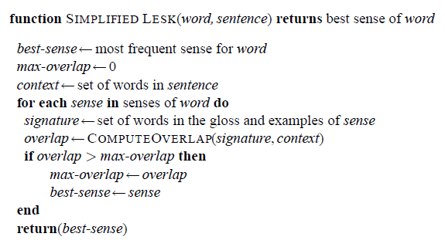
The Simplified Lesk Algorithm

Slide 60
Steps:
For the target word, get all its possible senses from a dictionary (e.g., WordNet).
For each sense, retrieve its definition (gloss).
Look at the context words around the target word.
For each context word, also retrieve its glosses.
Compute overlap (shared words) between glosses of the target word’s sense and the context words’ glosses.
The sense with the maximum overlap is selected

Slide 61
Example:
Sentence: “He went to the bank to deposit some money.”
Possible senses of bank:
bank₁ – “financial institution where people deposit money”
bank₂ – “sloping land beside a river”
Context words: went, deposit, money
Overlap computation:
bank₁ gloss shares words “deposit”, “money” → 2 overlaps
bank₂ gloss shares none → 0 overlaps
✅ Chosen sense: bank₁ (financial institution)

Slide 62
Minimally Supervised WSD: Bootstrapping Method
Both the supervised approach and the dictionary-based approach to WSD require large hand-built resources; supervised training sets in one case, large dictionaries in the other.
We can instead use bootstrapping algorithms, often called semi-supervised learning or minimally supervised learning, which need only a very small hand-labeled training set.
The most widely emulated bootstrapping algorithm for WSD is the Yarowsky algorithm.

Slide 63
Yarowsky algorithm
Dan Yarowsky (1995) introduced a highly influential bootstrapping algorithm for WSD that exploited two linguistic hypotheses: one-sense-per-collocation and one-sense-per-discourse.
It is known for achieving strong performance using very few seeds and simple features.
Algorithm Intuition: Find features (e.g., word to left, word to right, bigrams, collocations) that strongly indicate a sense. Use those to label the easiest cases first (high-precision), then use newly labeled examples to discover more features and label more cases

Slide 64
Yarowsky algorithm
The goal of the Yarowsky algorithm is to learn a classifier for a target word
Step 1: The algorithm is given a small seed-set Λ0 of labeled instances of each sense, and a much larger unlabeled corpus V0
Step 2: The algorithm first trains an initial decision-list classifier on the seed-set Λ0
Step 3: It then uses this classifier to label the unlabeled corpus V0
Step 4: The algorithm then selects the examples in V0 that it is most confident about, removes them, and adds them to the training set (call it now Λ1)

Slide 65
Step 5: The algorithm then trains a new decision list classifier (a new set of rules) on Λ1, and iterates by applying the classifier to the now-smaller unlabeled set V1, extracting a new training set Λ2 and so on.
With each iteration of this process, the training corpus grows and the untagged corpus shrinks.
The process is repeated until some sufficiently low error-rate on the training set is reached, or until no further examples from the untagged corpus are above threshold

Slide 66
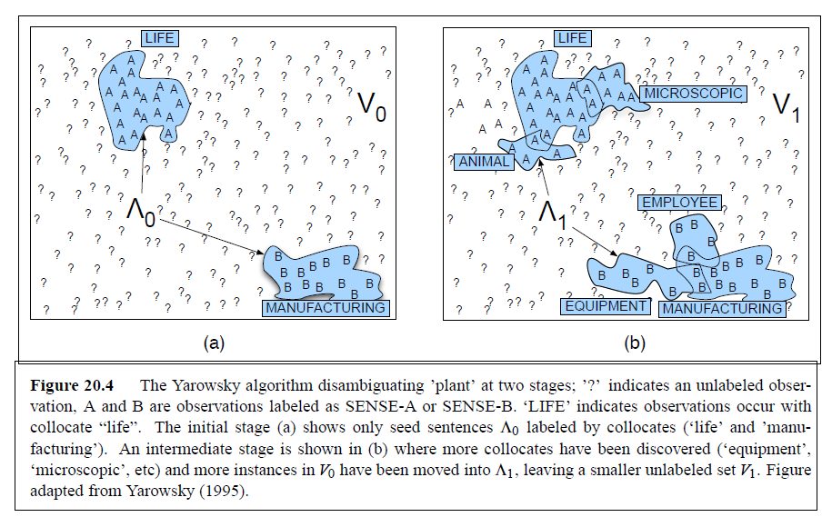

Slide 67
WORD SIMILARITY
Word similarity: score that quantifies how semantically close two lexical items are (e.g., car vs. automobile → high similarity; car vs. road → related but possibly lower similarity depending on measure)
Two useful distinctions:
Similarity (synonym-like, degree of interchangeability).
Relatedness (broader: co-occurrence/functional relation, e.g., car—road)
WSD often needs to measure similarity/relatedness.

Slide 68
Two main approaches :
Thesaurus-based similarity (knowledge driven)
Distributional methods (corpus/data-driven)
Thesaurus-based similarity (knowledge):
These use a structured lexical resource (synsets, hypernym/hyponym trees, glosses)
Basic Idea: Represent words by their synsets in a semantic network (graph) and compute distance or information-content measures using that graph.

Slide 69

Common approaches & formulas
A — Path / edge-count (simple)
Similarity inversely proportional to the shortest path length (number of edges) between synsets c1 and c2:
simpath​(c1​,c2​)=1/(len(c1​,c2​)+1)
B — Leacock–Chodorow (LCH)
Uses shortest path and taxonomy depth D:

Slide 70
Example:
“car” and “bus” in a Semantic Network
Below is a simplified semantic network showing part of WordNet’s is-a (hypernym) hierarchy.
Each node = a synset (concept),
Each edge = a semantic relation (e.g., is-a, hypernym/hyponym)

Slide 71
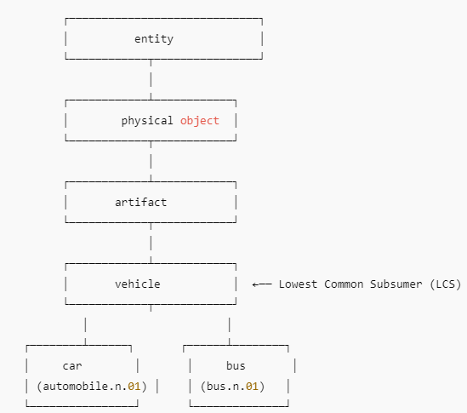
Graph representation

Slide 72
Similarity Computation Example:
Shortest path between car and bus:
car → vehicle → bus
path_length = 2
similarity = 1 / (1 + 2) = 0.33

Slide 73

Leacock–Chodorow (LCH) — calculation for car vs bus
Formula
where D = maximum depth of the taxonomy (longest root→leaf path), and the log is natural (ln)
Calculation:
Shortest path length between car and bus = 2 (car → vehicle → bus)

Slide 74
Assume maximum depth D=5 (we used depths: entity→… → vehicle → car, car depth = 5)
LCH=−ln(2/2x5​)=−ln(2/10​)=−ln(0.2)=1.6094
LCH(car, bus) ≈ 1.609
Therefore Larger LCH → more similar.

Slide 75
Distributional similarity (corpus-based)
These are corpus-based approaches that estimate word similarity from usage patterns in large text corpora — following the Distributional Hypothesis
“Words that occur in similar contexts tend to have similar meanings.”

Slide 76
Instead of relying on predefined semantic networks (like WordNet), distributional methods learn meaning directly from word co-occurrences in text
Each word = represented as a vector (numerical representation of its context).
Words with similar contexts → similar vectors → high cosine similarity.

Slide 77
Types of Distributional Methods
Type | Example | Description
Count-based | Co-occurrence Matrix, PPMI, LSA | Uses raw frequency counts of words in context windows
Prediction-based | Word2Vec, GloVe, FastText | Learns embeddings by predicting contexts or words

Slide 78
Example
Example corpus:
1. The car is on the road.
2. The bus is on the road.
3. The car and the bus are vehicles.
Step 1: Build Co-occurrence Matrix
We take a small context window (say, 2 words on each side)
Target Word | car | Bus | Road | Vehicle | The | Is | On
car | 0 | 1 | 1 | 1 | 1 | 1 | 1
Bus | 1 | 0 | 1 | 1 | 1 | 1 | 1
Road | 1 | 1 | 0 | 0 | 1 | 1 | 1
Vehicle | 1 | 1 | 0 | 0 | 0 | 0 | 0
(Numbers are counts of how often each pair appeared near each other.)

Slide 79
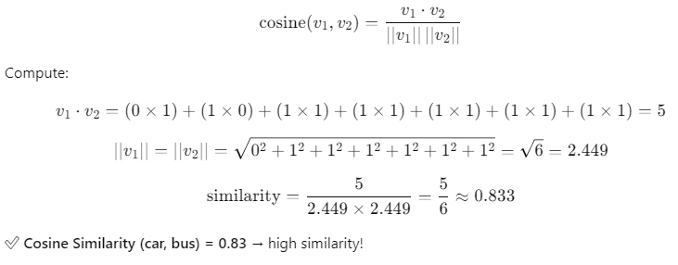
Step 2. Convert to vectors
v(car) = [0,1,1,1,1,1,1]
v(bus) = [1,0,1,1,1,1,1]
Step 3. Compute Cosine Similarity

